Slide 1
Deep Learning application for time-series analysis and its application for climate science
Soo Kim
Lawrence Livermore National Laboratories

Slide 2
Outline
RNN
LSTM
ConvLSTM
Application of ConvLSTM for hurricane tracking
Sources: Tensorflow for deep learning research: https://web.stanford.edu/class/cs20si/2017/
MNIST for ML Beginner: https://www.tensorflow.org/tutorials/

Slide 3
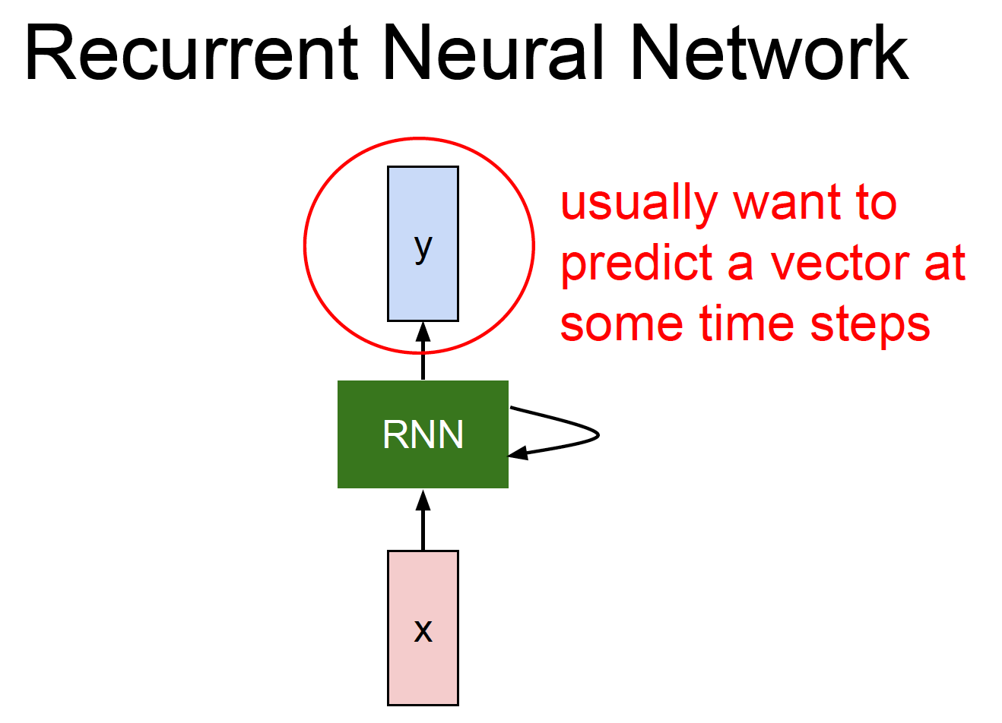

Slide 4
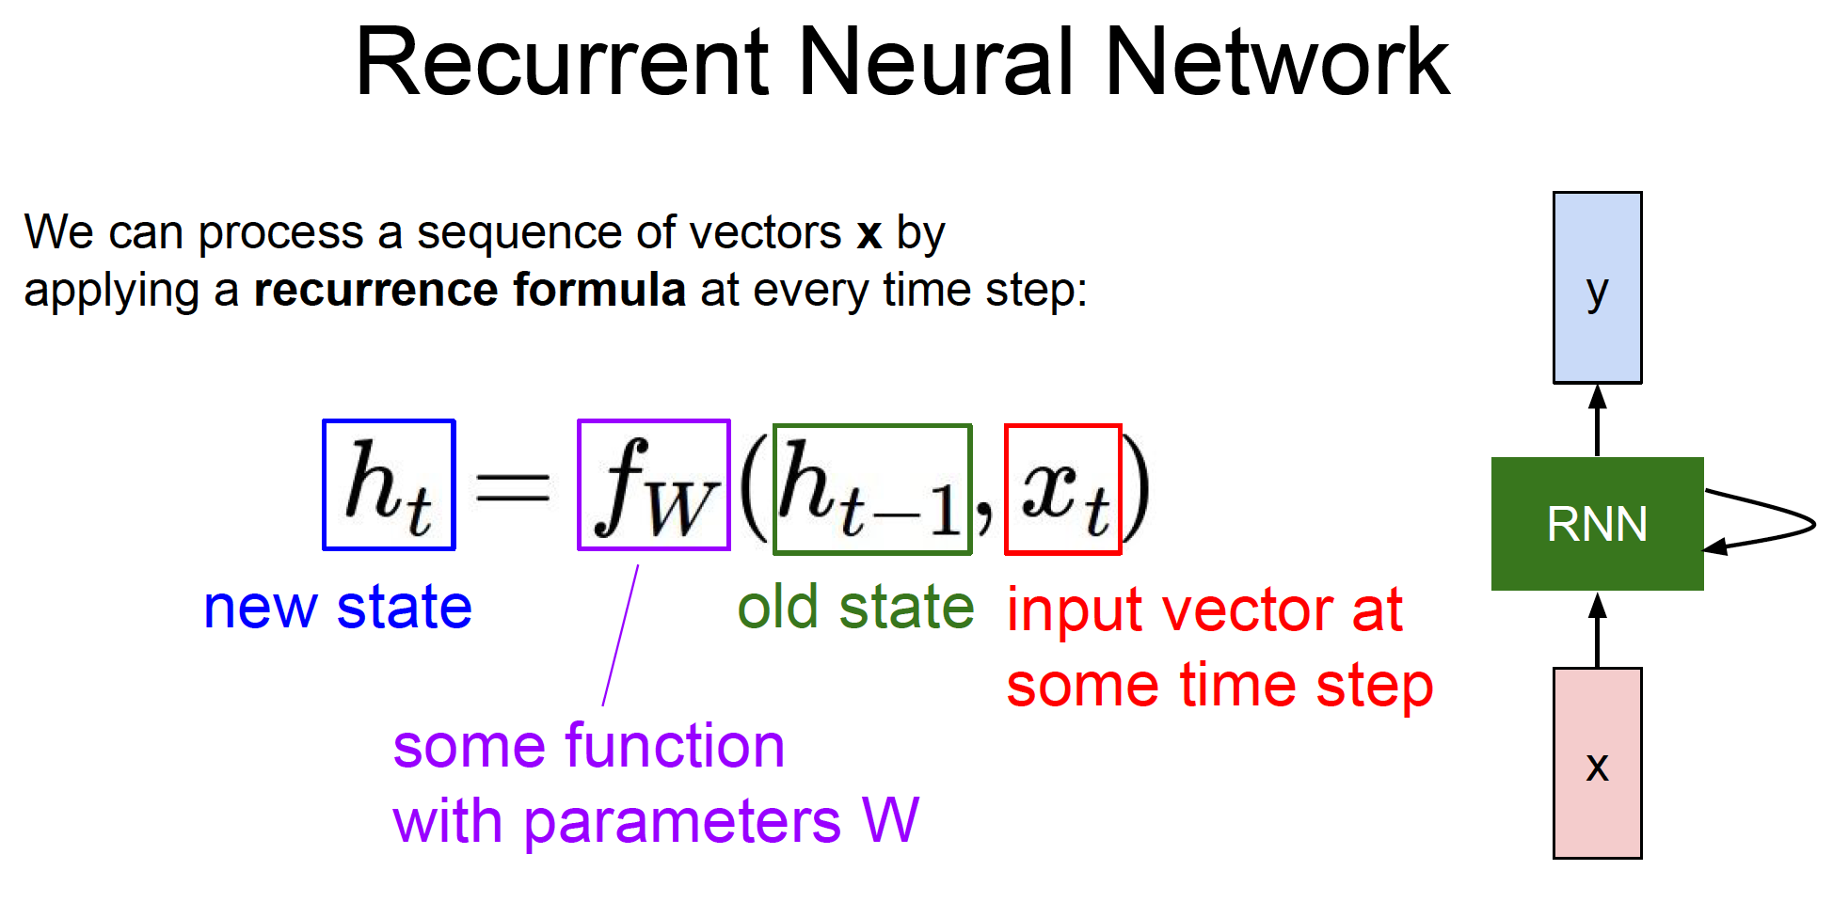

Slide 5
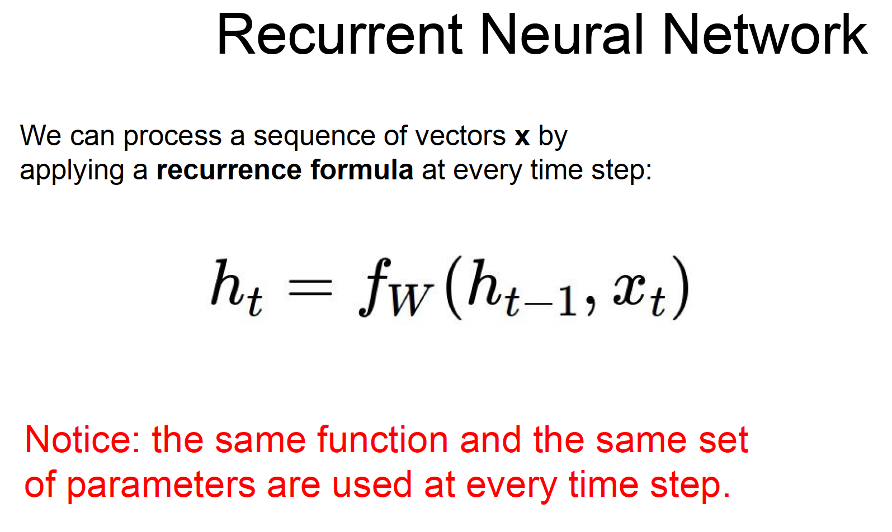
unrolling
Y_{t}
RNN_t-1
RNN_t
RNN_t+1
h_{t-1}
h_{t}
X_{t}

Slide 6
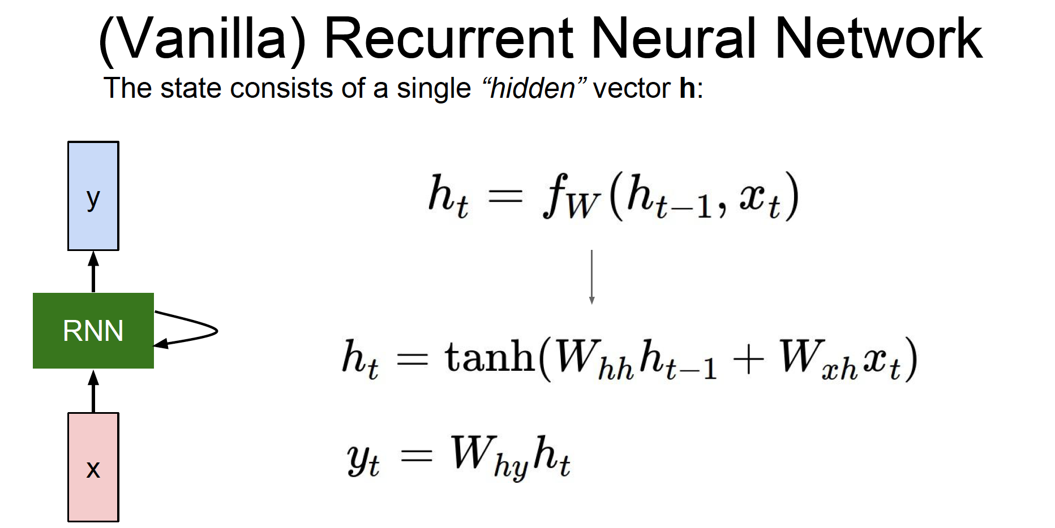
unrolling
Y_{t}
RNN_t-1
RNN_t
RNN_t+1
h_{t-1}
h_{t}
X_{t}

Slide 7
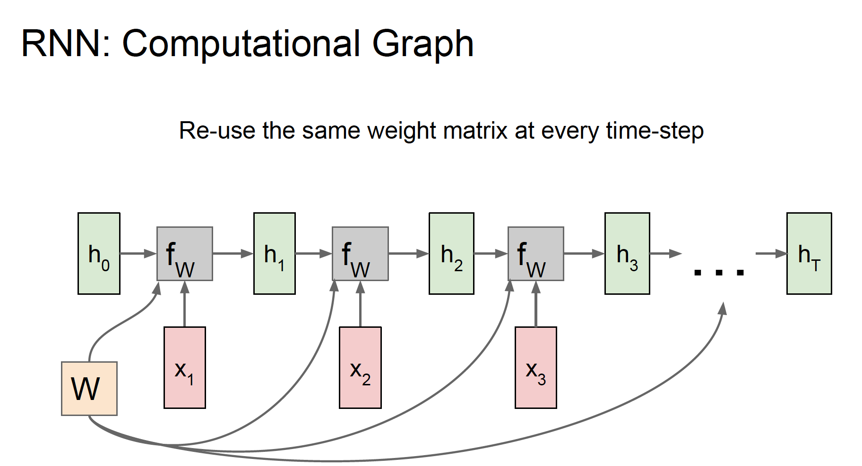

Slide 8
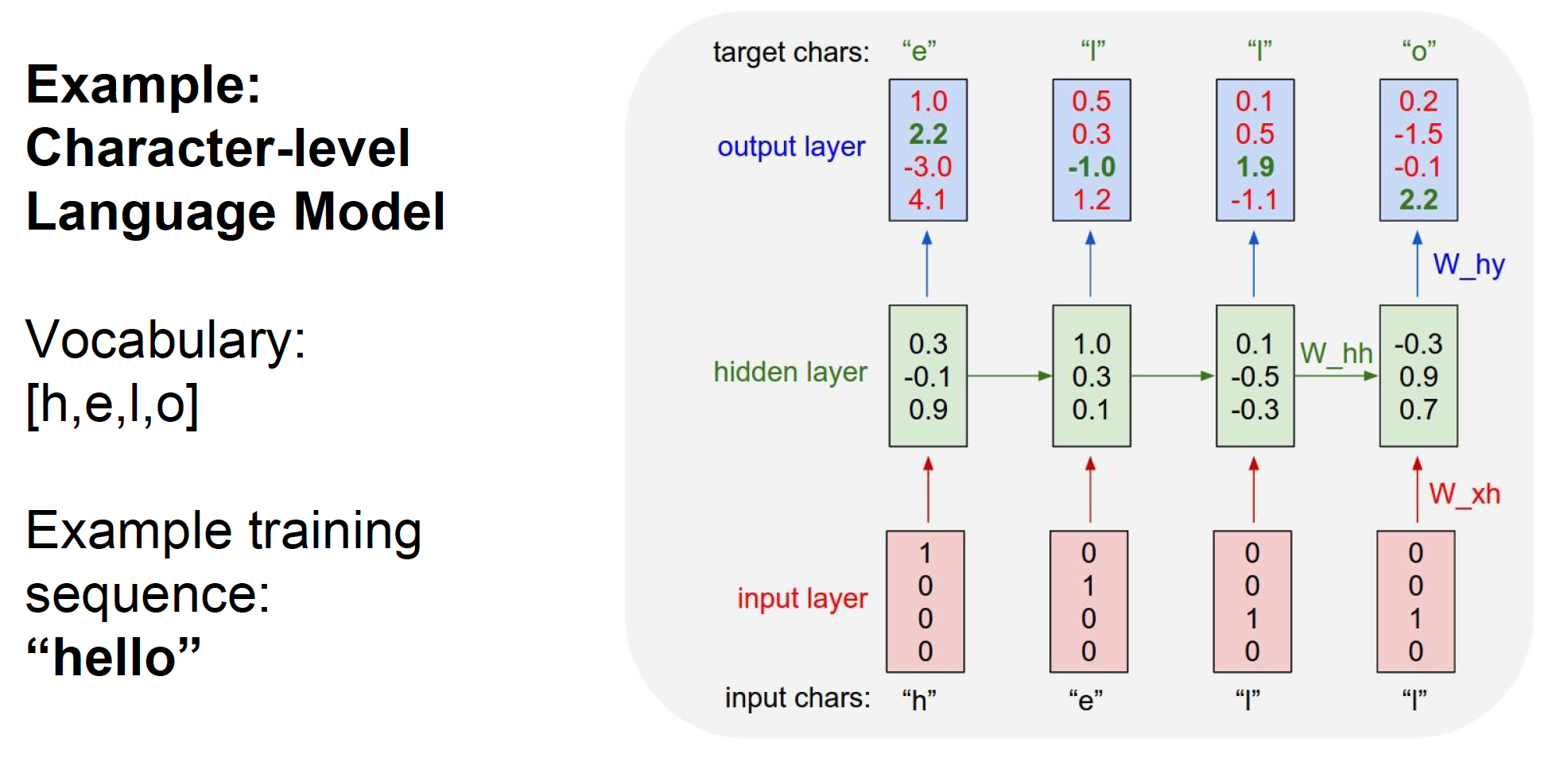

Slide 9
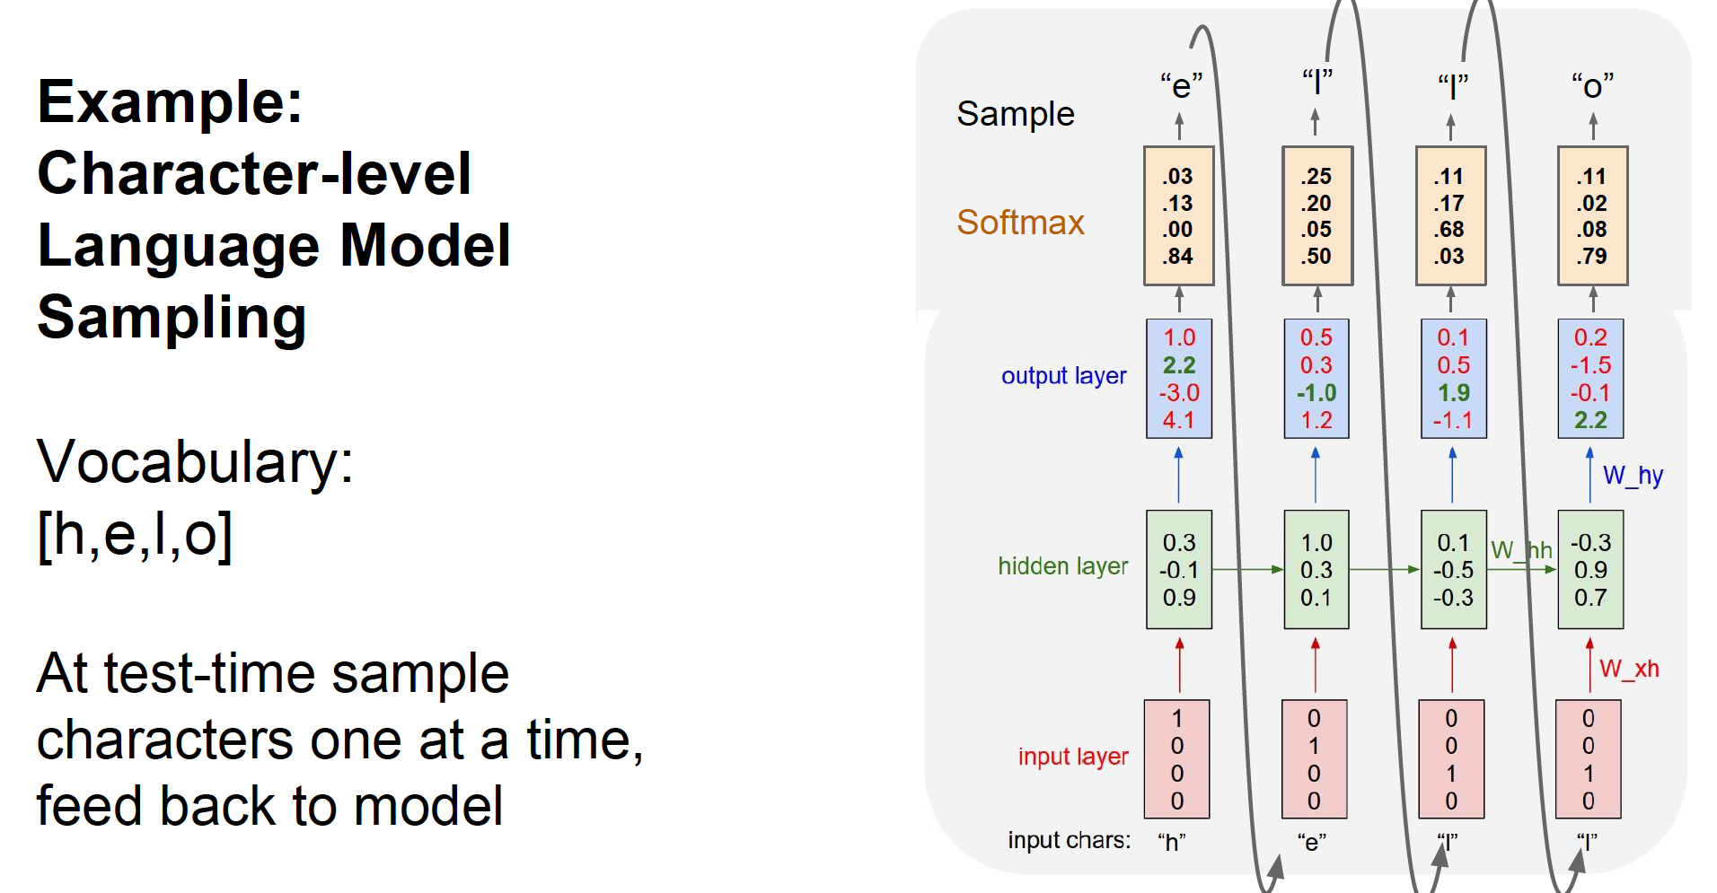

Slide 10
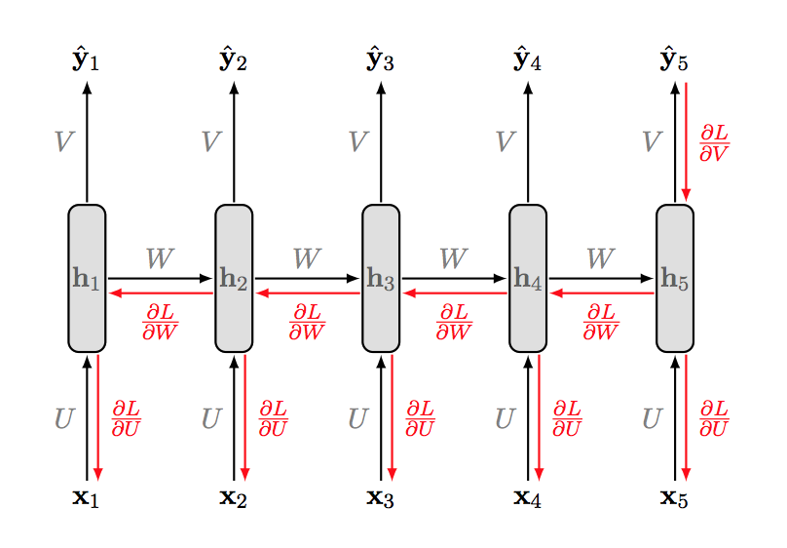
Vanishing Gradient Problem
Basic problem of RNN:
Gradients propagated over many stages tend to vanish (most of the time) or explode (relatively rarely)

Slide 11
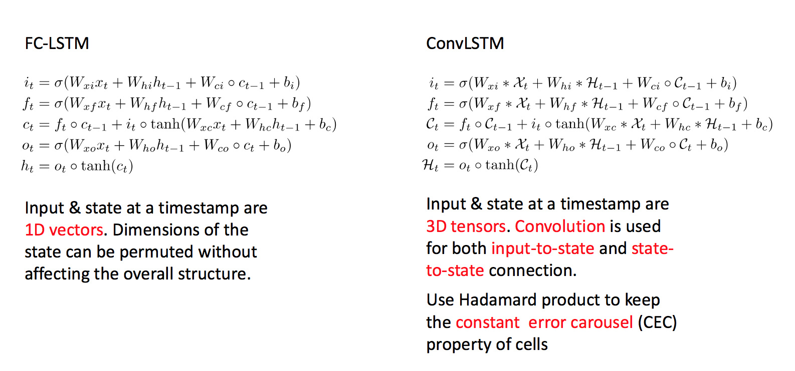
Long Short Term Memory (LSTM)
FC-LSTM
https://colah.github.io/posts/2015-08-Understanding-LSTMs/
Notes:
Okay. We could predict multiple J sequences in future by using encoder and decoder structure.
The another question is now arising.
Then, how can we deal with spatiotemporal data?
Lstm which consisted of fully connected and small hidden state is good to represent simple time series data, such as language or value typed data.
But its not enough to contain spatial correlation information, because it just consider image feature as vector and try to save it as small hidden representation.
Therefore, lstm is not enough to deal with spatiotemporal data.

Slide 12
Application for Climate Data
Notes:
I would like to show you one showcase of failure of Fully connected lstm to analyze spatiotemporal data.
In my hurricane trajectory tracking problem, I tried to use fully connected lstm to follow trajectory of hurricane.
So, input is time series climate images containing hurricane, and output is coordinate of specific hurricane location.
And I found this tragic sad result.
This is mainly because fully connected lstm doesn’t have capability to capture spatial correlation in image like convolutional nets.

Slide 13
How to deal with spatiotemporal data?
A pure encoding-prediction structure is not enough.
We are dealing with spatiotemporal data.
Notes:
I would like to show you one showcase of failure of Fully connected lstm to analyze spatiotemporal data.
In my hurricane trajectory tracking problem, I tried to use fully connected lstm to follow trajectory of hurricane.
So, input is time series climate images containing hurricane, and output is coordinate of specific hurricane location.
And I found this tragic sad result.
This is mainly because fully connected lstm doesn’t have capability to capture spatial correlation in image like convolutional nets.

Slide 14
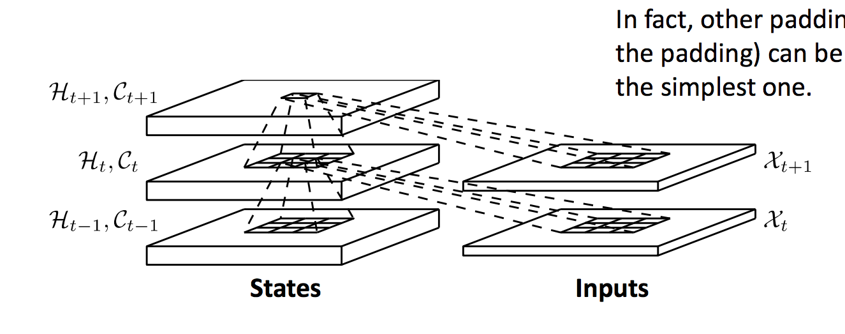
How to deal with spatiotemporal data? : ConvLSTM
Input and state at a timestep are 3-d tensors.
Convolution is used for both input-to-state and state-to-state connection.
Conv-part: capture spatial information
LSTM-part: capture temporal information
Notes:
Okay. We could predict multiple J sequences in future by using encoder and decoder structure.
The another question is now arising.
Then, how can we deal with spatiotemporal data?
Lstm which consisted of fully connected and small hidden state is good to represent simple time series data, such as language or value typed data.
But its not enough to contain spatial correlation information, because it just consider image feature as vector and try to save it as small hidden representation.
Therefore, lstm is not enough to deal with spatiotemporal data.

Slide 15
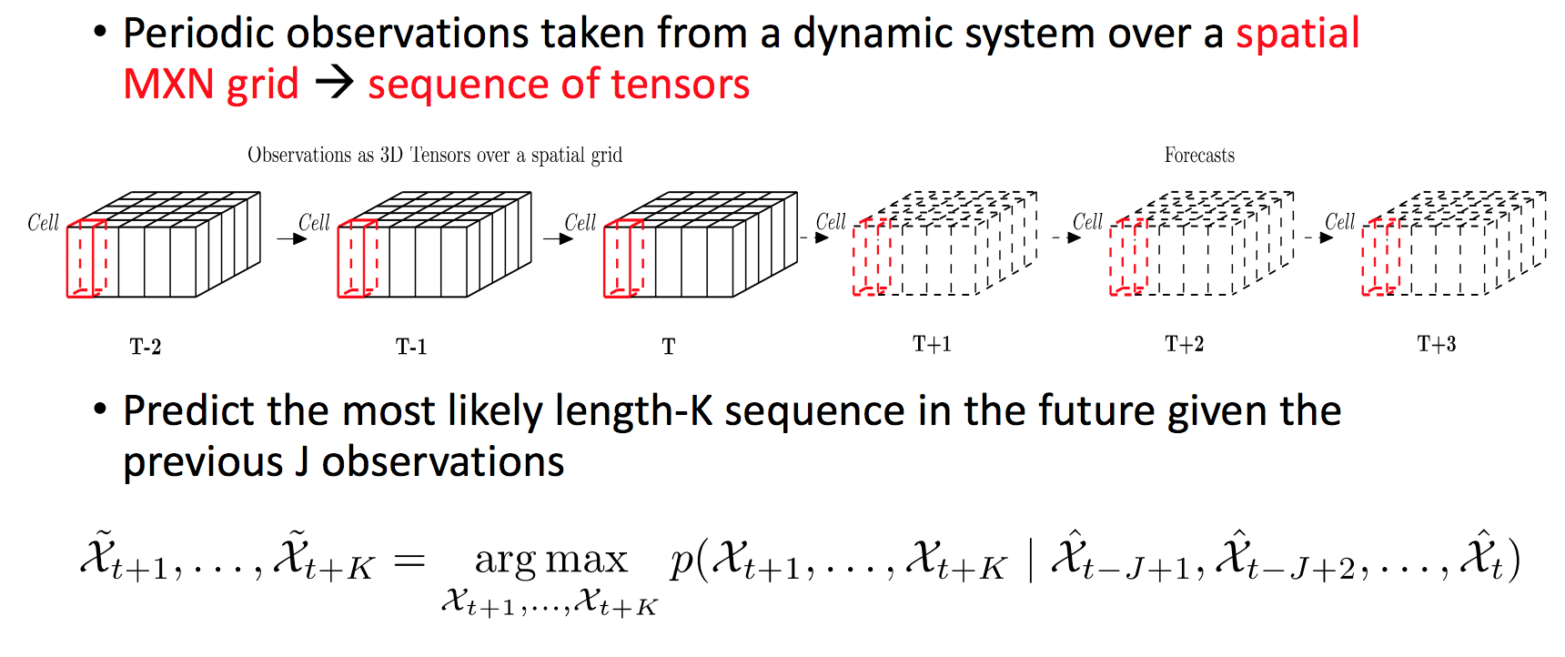
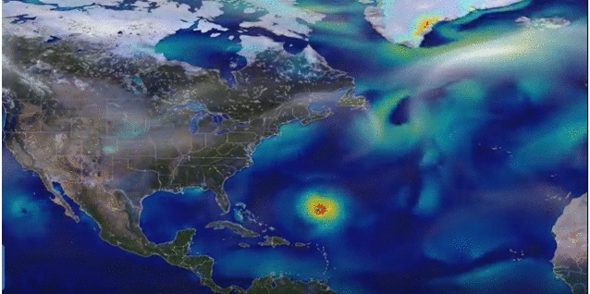
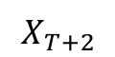

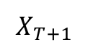
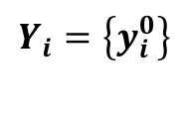
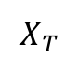
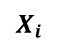
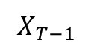
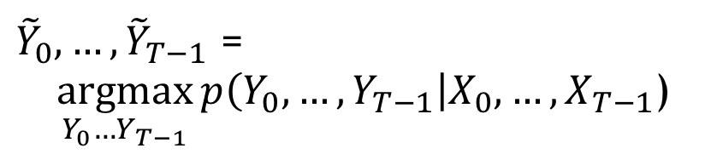
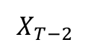
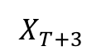
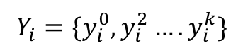
Application of ConvLSTM for hurricane tracking
Input: Spatiotemporal climate data taken from a physics based climate simulation.
Spatial m x n x c grid sequence of tensor (4D tensors).
c
n
m
$$X_{T−2}$$
$$X_{T−1}$$
$$X_{T}$$
$$X_{T+1}$$
$$X_{T+2}$$
$$X_{T+3}$$
Output: Set of vectors of k coordinates of hurricane centers existing in corresponding input image X_{i} :
$$Y_{i}=\{y_{i}^{0},y_{i}^{2}….y_{i}^{k}\}$$
${\tilde{Y}}_{0},…,{\tilde{Y}}_{T−1}$ = $$\underset{Y_{0}…Y_{T−1}}{argmax}{p\left(Y_{0},…,Y_{T−1}\right|X_{0},…,X_{T−1}\text{)}}$$
$$y_{i}^{0}=(a_{i}^{0},b_{i}^{0})$$
$$Y_{i}=\left\{y_{i}^{0}\right\}$$
$$X_{i}$$

Slide 16
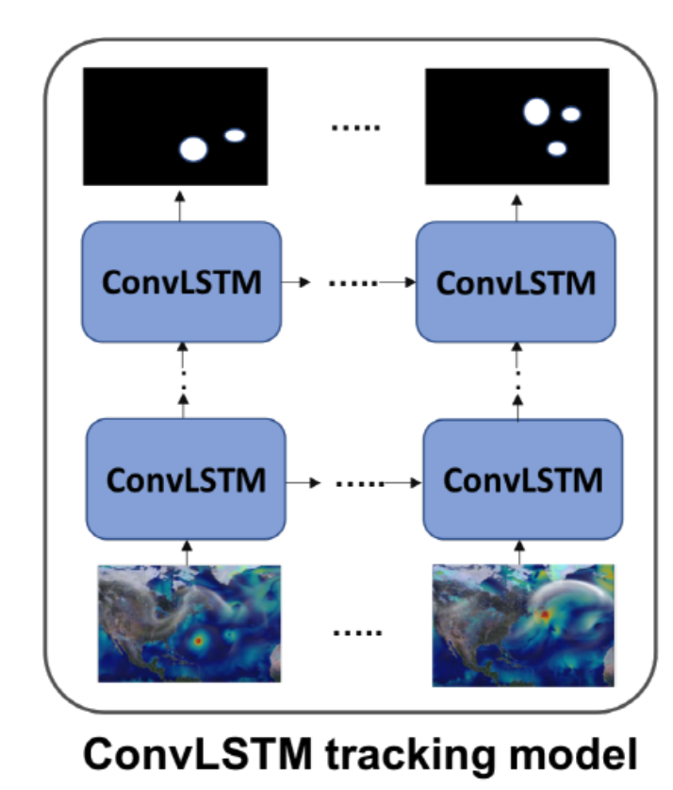

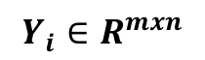

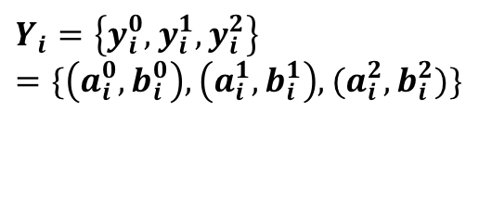


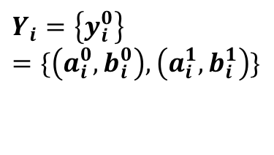

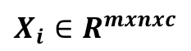


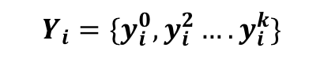


Problem Statement: Proposed Model
k (number of object) is not known previously.→ Difficult to formulate output Y_{i}
Design output Y_{i} as density-map with same size of input X_{i} (mxn)
$X_{i}$ $∈R^{mxnxc}$
$$Y_{i}=\{y_{i}^{0},y_{i}^{2}….y_{i}^{k}\}$$
$$Y_{i}∈R^{mxn}$$
$$y_{i}^{1}$$
$$Y_{i}=\left\{y_{i}^{0}\right\} \\ =\{\left(a_{i}^{0},b_{i}^{0}\right),\left(a_{i}^{1},b_{i}^{1}\right)\}$$
$$y_{i}^{0}$$
$$y_{i}^{1}$$
$$y_{i}^{0}$$
$$y_{i}^{0}$$
$$y_{i}^{0}$$
$$y_{i}^{1}$$
$$y_{i}^{1}$$
$$Y_{i}=\left\{y_{i}^{0},y_{i}^{1},y_{i}^{2}\right\}=\{\left(a_{i}^{0},b_{i}^{0}\right),\left(a_{i}^{1},b_{i}^{1}\right),(a_{i}^{2},b_{i}^{2})\}$$
$$y_{i}^{2}$$
$$y_{i}^{2}$$
Design problem as pixel-wise regression problem from X to Y

Slide 17
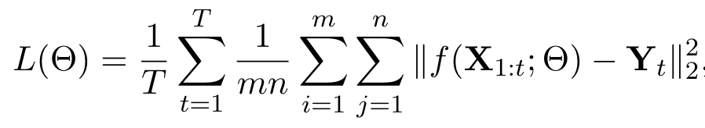
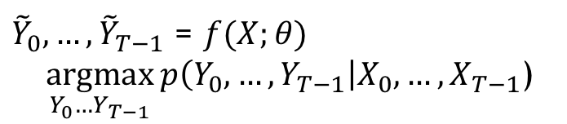
Proposed Tracking Model using Conv-LSTM
${\tilde{Y}}_{0},…,{\tilde{Y}}_{T−1}$ = $f(X;θ)$
$$\underset{Y_{0}…Y_{T−1}}{argmax}{p\left(Y_{0},…,Y_{T−1}\right|X_{0},…,X_{T−1}\text{)}}$$
f: Multi-layered Conv-LSTM
3-layered and 4-layered
Input-to-state, state-to-state kernel: 5x5
Input-size: 128x257x3
Output-size: 128x257x1 (adopted filter with 3x1 size)
Loss: pixel-wise MSE btw output and GT

Slide 18
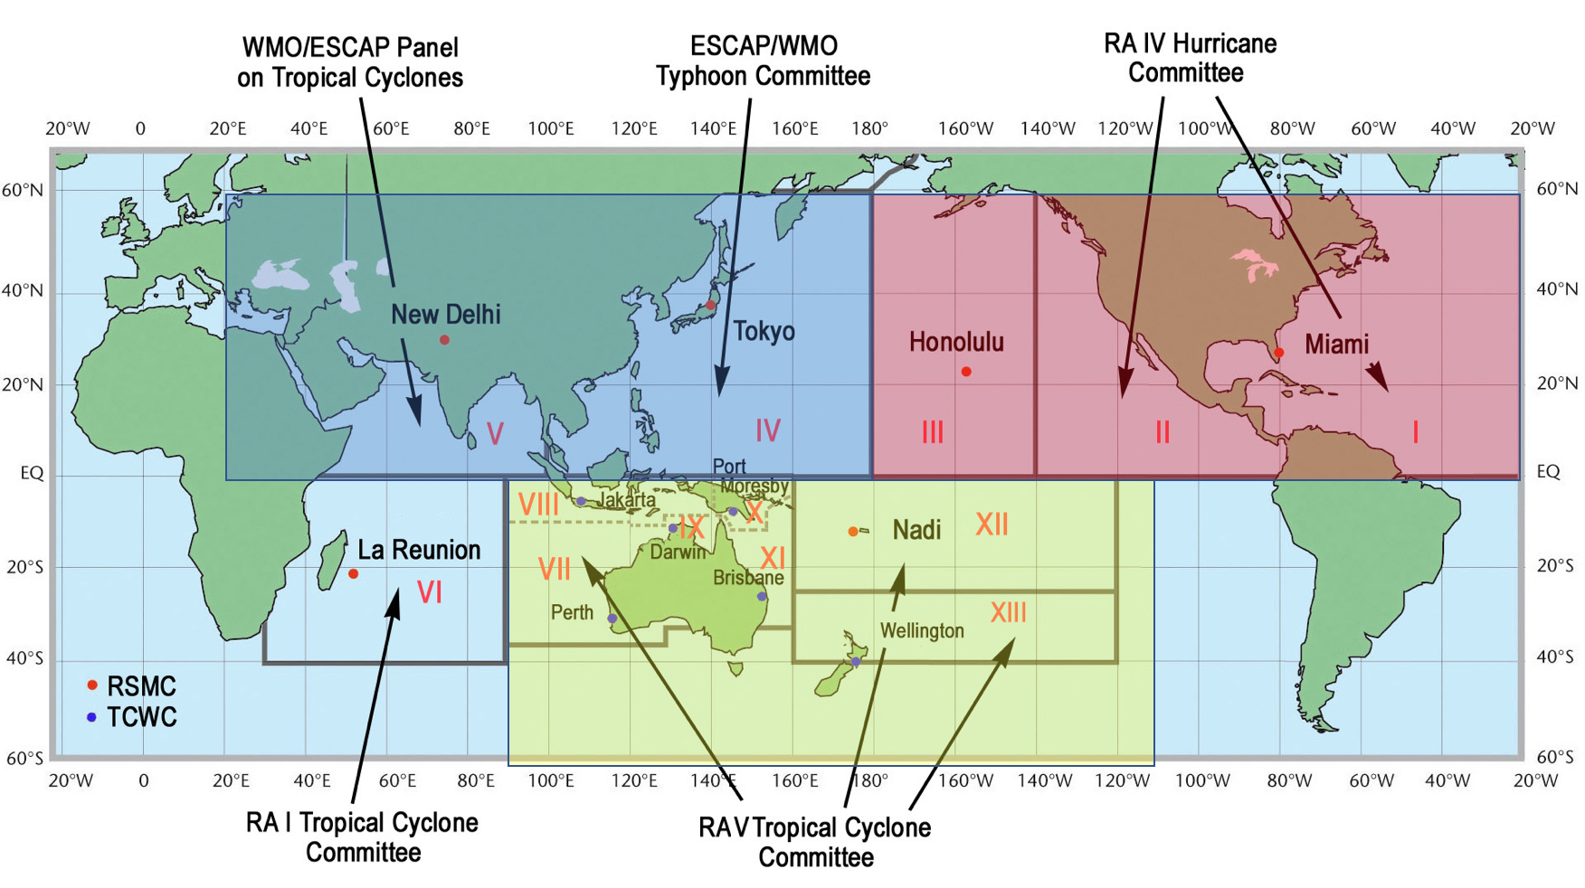
Experimental Settings
Dataset
20-year run (1996 to 2015) 3 hourly climate simulation data : CAM5 (Community atmospheric model v5)
Climate variables: zonal wind (U850), Meridional wind (V850), Precipitation (PRECT)
Time-steps: 10 (30 hours)
Label: Ground-truth trajectories obtained from TECA (Toolkit got Extreme Climate Analysis)
Size of data: 160 degree (longitude) x 60 degree (latitude) collected from non-overlapping basins
Resolution: 2x2 down sample (~0.5 degree)

Slide 19
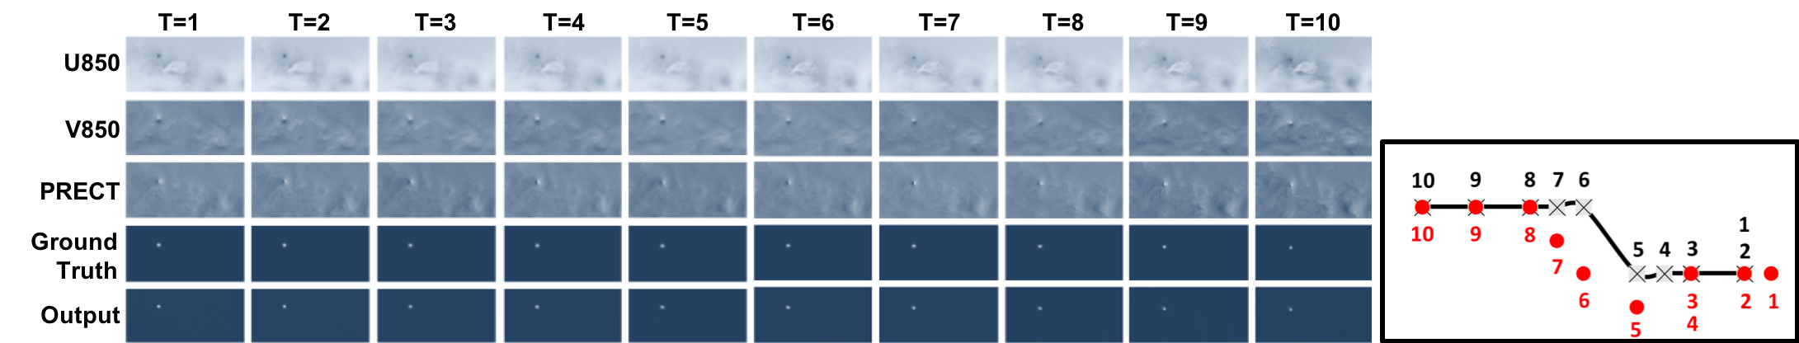
Results
Results from conv-LSTM based tracking model

